Slide 1
Mandatory NSW Government QR code expansion
Communication toolkit for peak bodies and businesses
9 July 2021

Slide 2
Purpose of this toolkit
COVID-19 remains a risk to community safety and keeping our economy on track. As we have seen, together with testing, COVID safe behaviours and vaccination, timely contact tracing is critical in helping contain outbreaks when they occur.
That’s why from Monday 12 July, it will be mandatory for more businesses and organisations to use the NSW Government QR code to check in everyone who visits their premises, in addition to the places where check in is currently required. This includes but is not limited to:
Retail businesses, supermarkets and individual shops within shopping centres
Shopping centres (QR codes to be displayed at entry points where practicable)
Gyms
Offices including call centres
Manufacturing and warehousing
School, university or other educational institutions (excluding students entering the school)
Taxis and hire vehicles, including rideshare
Please see the complete list of workplaces and businesses required to use the NSW Government QR code.
This toolkit contains adaptable website/newsletter copy, posters and social media posts to help you communicate with businesses and customers about this change.
Your support continues to play a critical role in helping stop the spread of COVID-19 in our community.

Slide 3
Communication content for peak bodies
This section contains newsletter/website copy and social media posts to help communicate with businesses.

Slide 4
Peak bodies to businesses and organisations: newsletter/website copy
The NSW Government QR code is now mandatory at more businesses and organisations
Contact tracing is one of the most powerful tools to help stop the spread of COVID-19. That’s why from 12:01am Monday 12 July, it will be mandatory for more businesses and organisations to use the NSW Government QR code system to check in every person who visits their premises including staff, customers and other visitors such as delivery drivers and maintenance workers.
If your business does not already have a NSW Government QR code, there are three steps you need to take:
Complete a COVID-19 Safety Plan Visit http://www.nsw.gov.au/covid-19/covid-safe to check if you need to have a safety plan. Select the safety plan template for your industry. Keep a copy of your plan in your premises so it can be provided to an authorised NSW Government official if asked. Please ensure you update your Safety Plan if public health measures change.
Register your business as COVID Safe Once you’ve completed your COVID-19 Safety Plan, you can register as a COVID Safe business. Visit www.nsw.gov.au/register-your-business-as-covid-safe and fill out the form. If you need to register 20 or more businesses or business locations, use the bulk upload request form.
Download and display your NSW Government QR code Now that your business is registered as COVID Safe, you can access your unique QR code through our business resource centre. You’ll also have access to a range of signage and posters that you can display at your business to let customers and visitors know you’re looking after their health and wellbeing. Your QR code should be displayed in a prominent position at the entry to your premises. Everyone who visits your business will be able to check in and out using the Service NSW app or the webform.
If a person refuses to check in at your premises, you may refuse entry to that person. It is a matter for the occupier of each premises to exercise judgement on what is appropriate for your premises and for the well-being of your staff and customers. If you intend to refuse entry, you should first ensure you are familiar with the exceptions and that you have spoken to the person and understand their circumstances.
For more information on how to register as COVID Safe or the NSW Government QR code visit nsw.gov.au or call Service NSW on 13 77 88 and ask to speak with a Business Concierge. For any other enquiries please email CovidSafeEnquiries@service.nsw.gov.au. Translating and interpreting services are available 24 hours a day, 7 days a week on 131 450 or tisnational.gov.au.​
Thank you for helping protect the community and supporting our industry.

Slide 5
Peak bodies to businesses and organisations: social content
To download, right click on tile and select ‘Save as picture’ or click the link above each image for a higher resolution version
Click here to download hi-res image
Click here to download hi-res image
Click here to download hi-res image
Post: From Monday 12 July, more businesses and organisations must have the NSW Government QR code in place to check in and out every person who visits. Learn more at nsw.gov.au
Post: It is mandatory for more businesses and organisations to have the NSW Government QR code from Monday 12 July. If you haven’t downloaded your NSW Government QR code, now is the time to do so. Learn more at nsw.gov.au
Post: Contact tracing is one of the most powerful tools we have to help stop the spread of COVID-19. That's why it's mandatory for more businesses and organisations to use the NSW Government QR code from Monday 12 July. Learn more at nsw.gov.au

Slide 6
Communication content for businesses
This section contains newsletter/website copy, social media posts and posters to help communicate with customers.

Slide 7
Businesses to customers: newsletter/website copy
Help us stay safe and open by checking in and out
New COVID-19 cases in the NSW community mean we are being extra careful to protect everyone who visits us. An important part of this is checking in and out using the NSW Government QR code. This supports contact tracing – one of the most powerful tools we have to help stop the spread of COVID-19. ​
Simply scan the QR code with your smartphone camera or QR code reader when you enter, follow the prompts and when completed show our team the green tick on your phone to confirm you are checked in.
It is even quicker and easier if you have the Service NSW app on your phone.​ If you don't have a smartphone, don’t worry. We will collect your details electronically.
We have our COVID-19 Safety Plan in place to protect you during your visit. If you are unwell, please stay at home, get tested immediately and follow the health advice.
We appreciate your understanding and support of our business during the pandemic. We know we can count on you to work with us to ensure we play our role in helping stop the spread of COVID-19.

Slide 8
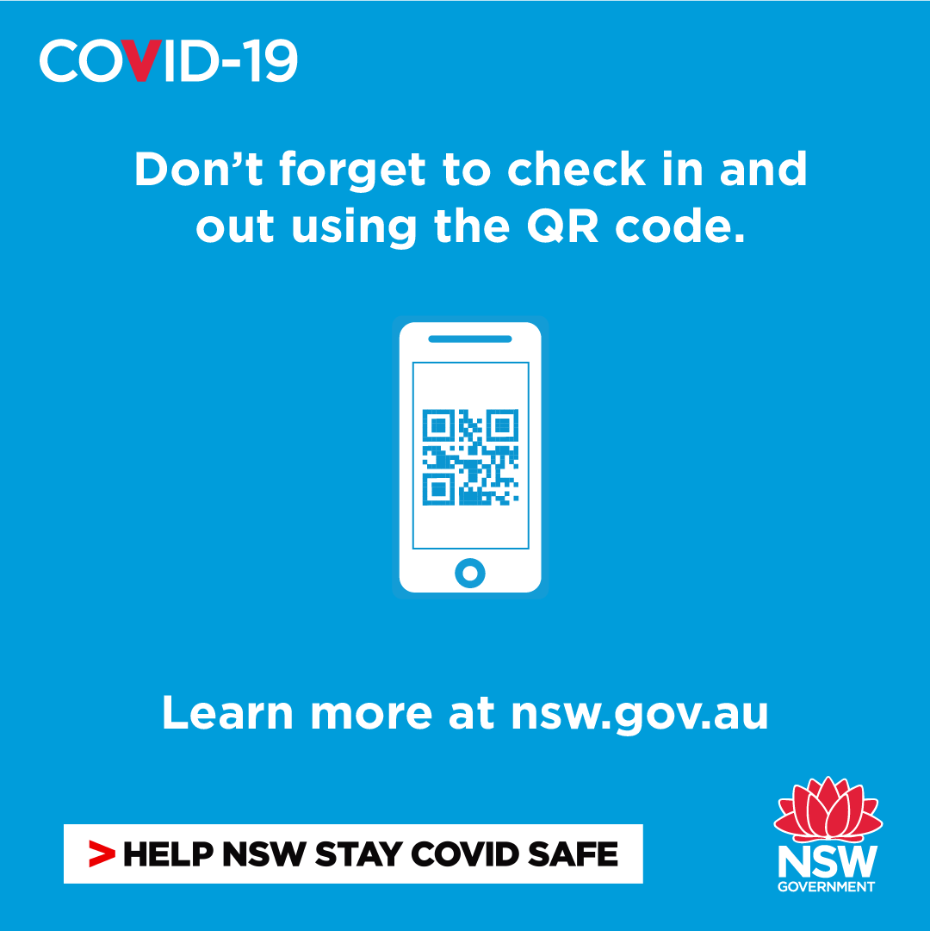
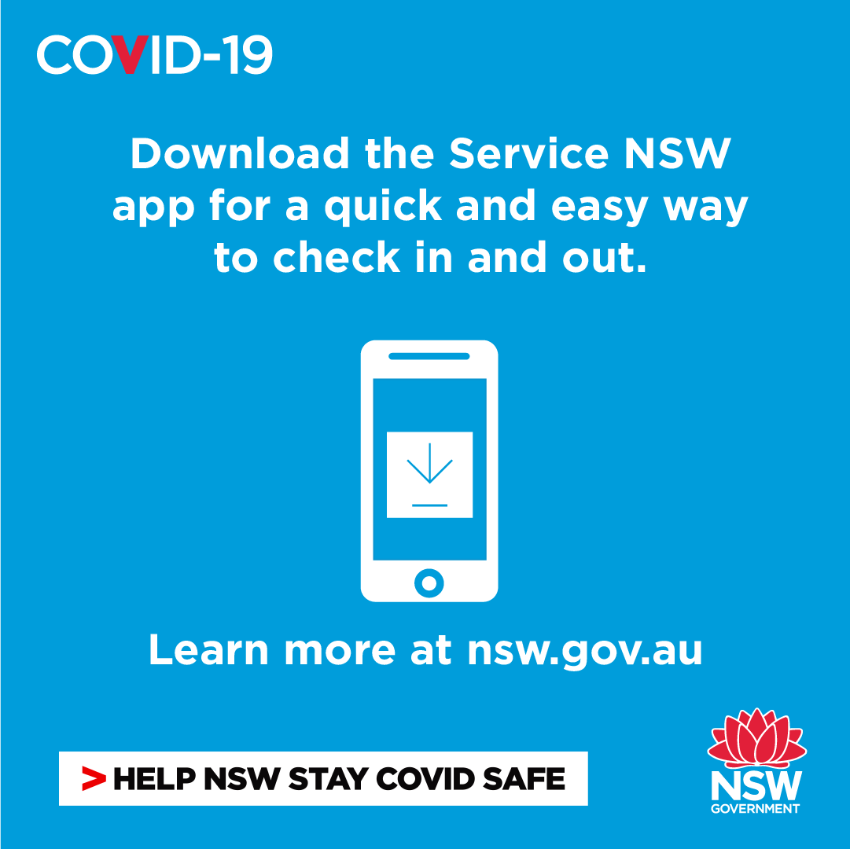
Businesses to customers: social content
To download, right click on tile and select ‘Save as picture’ or click the link above each image for a higher resolution version
Click here to download hi-res image
Click here to download hi-res image
Click here to download hi-res image
Post: Everyone is required to check in and out using the NSW Government QR code when they visit our business. It’s a simple step that makes all the difference to contact tracing efforts. Thank you for your cooperation. ​
Post: Checking in and out using the NSW Government QR code helps support contact tracing which is one of the most powerful tools we have to help stop the spread of COVID-19. Thank you for your cooperation.
Post: Our business uses the NSW Government QR code. Download the Service NSW app before you visit us to make checking in and out quicker and easier.

Slide 9
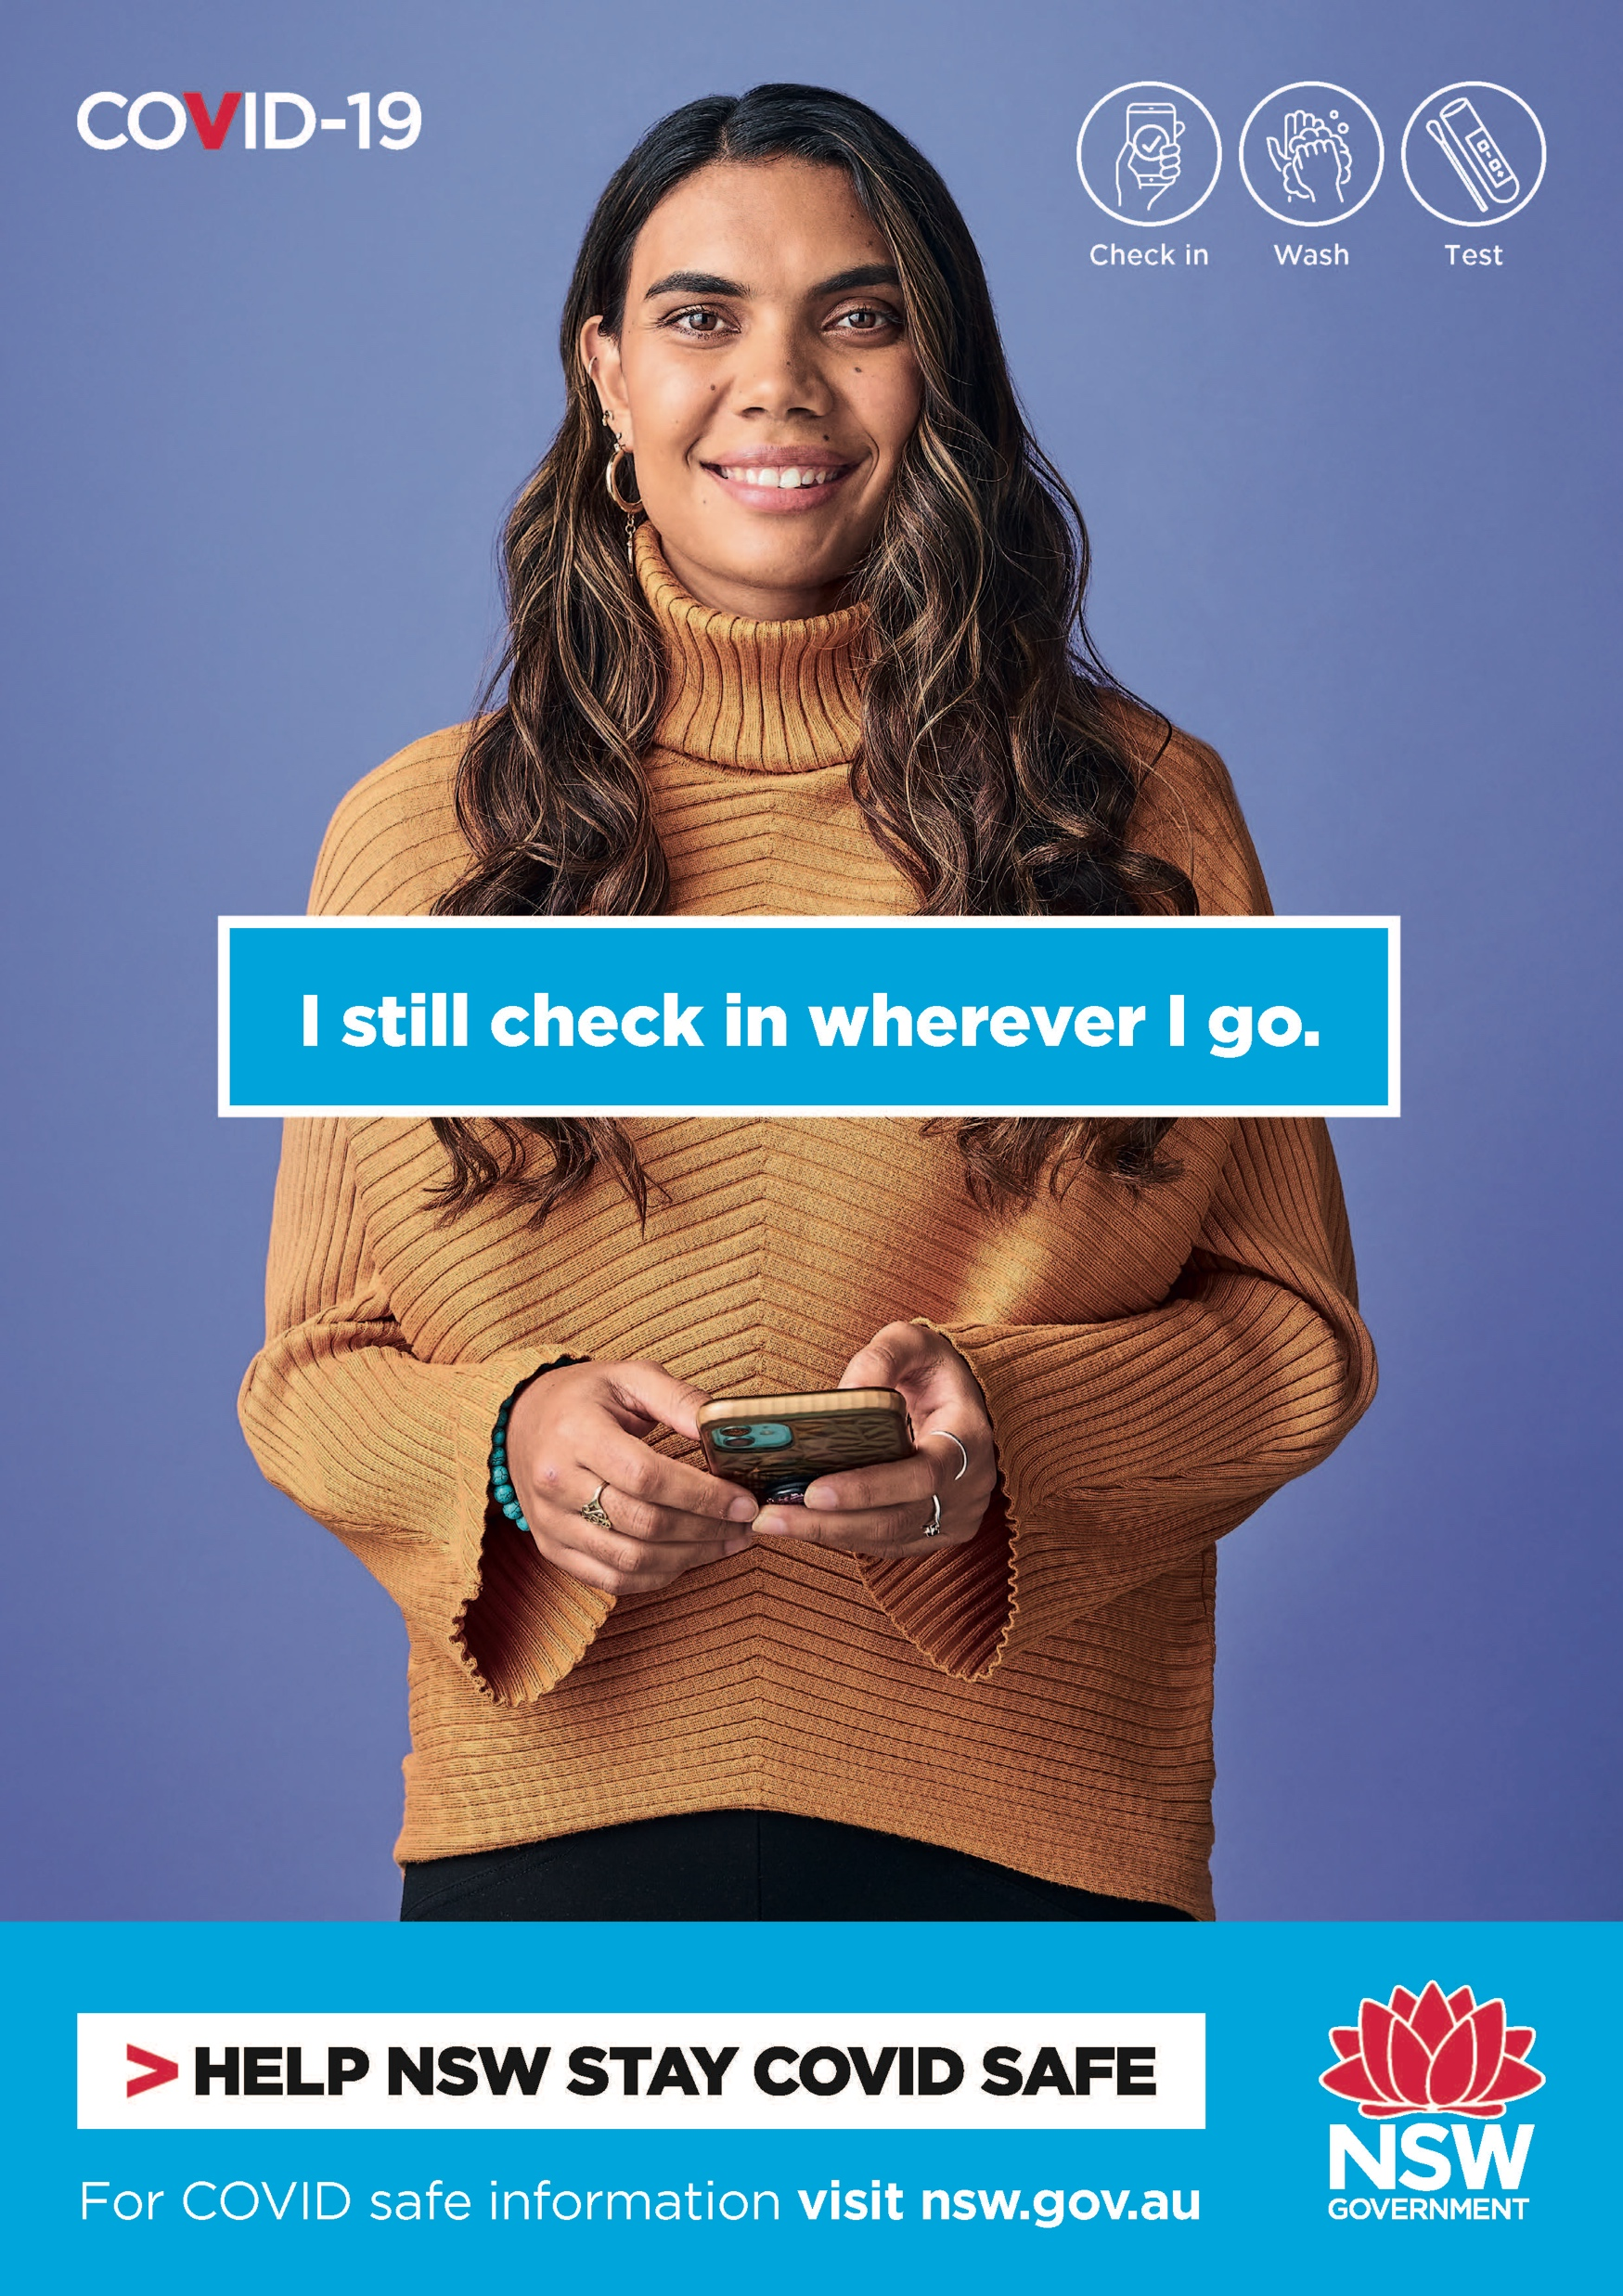
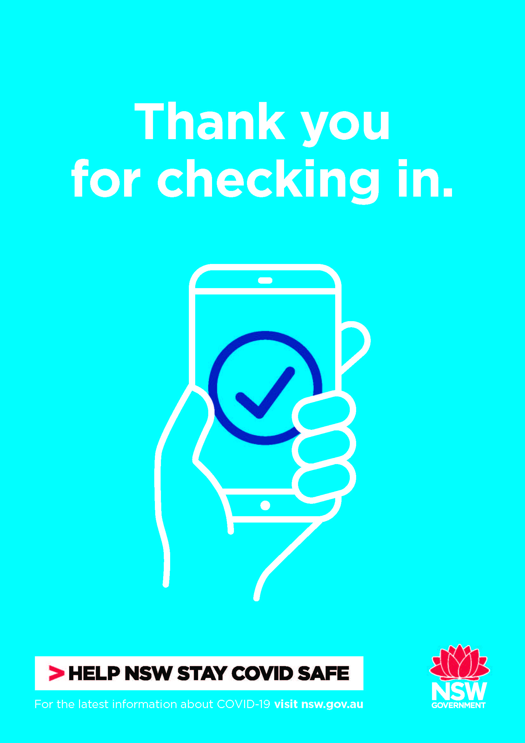
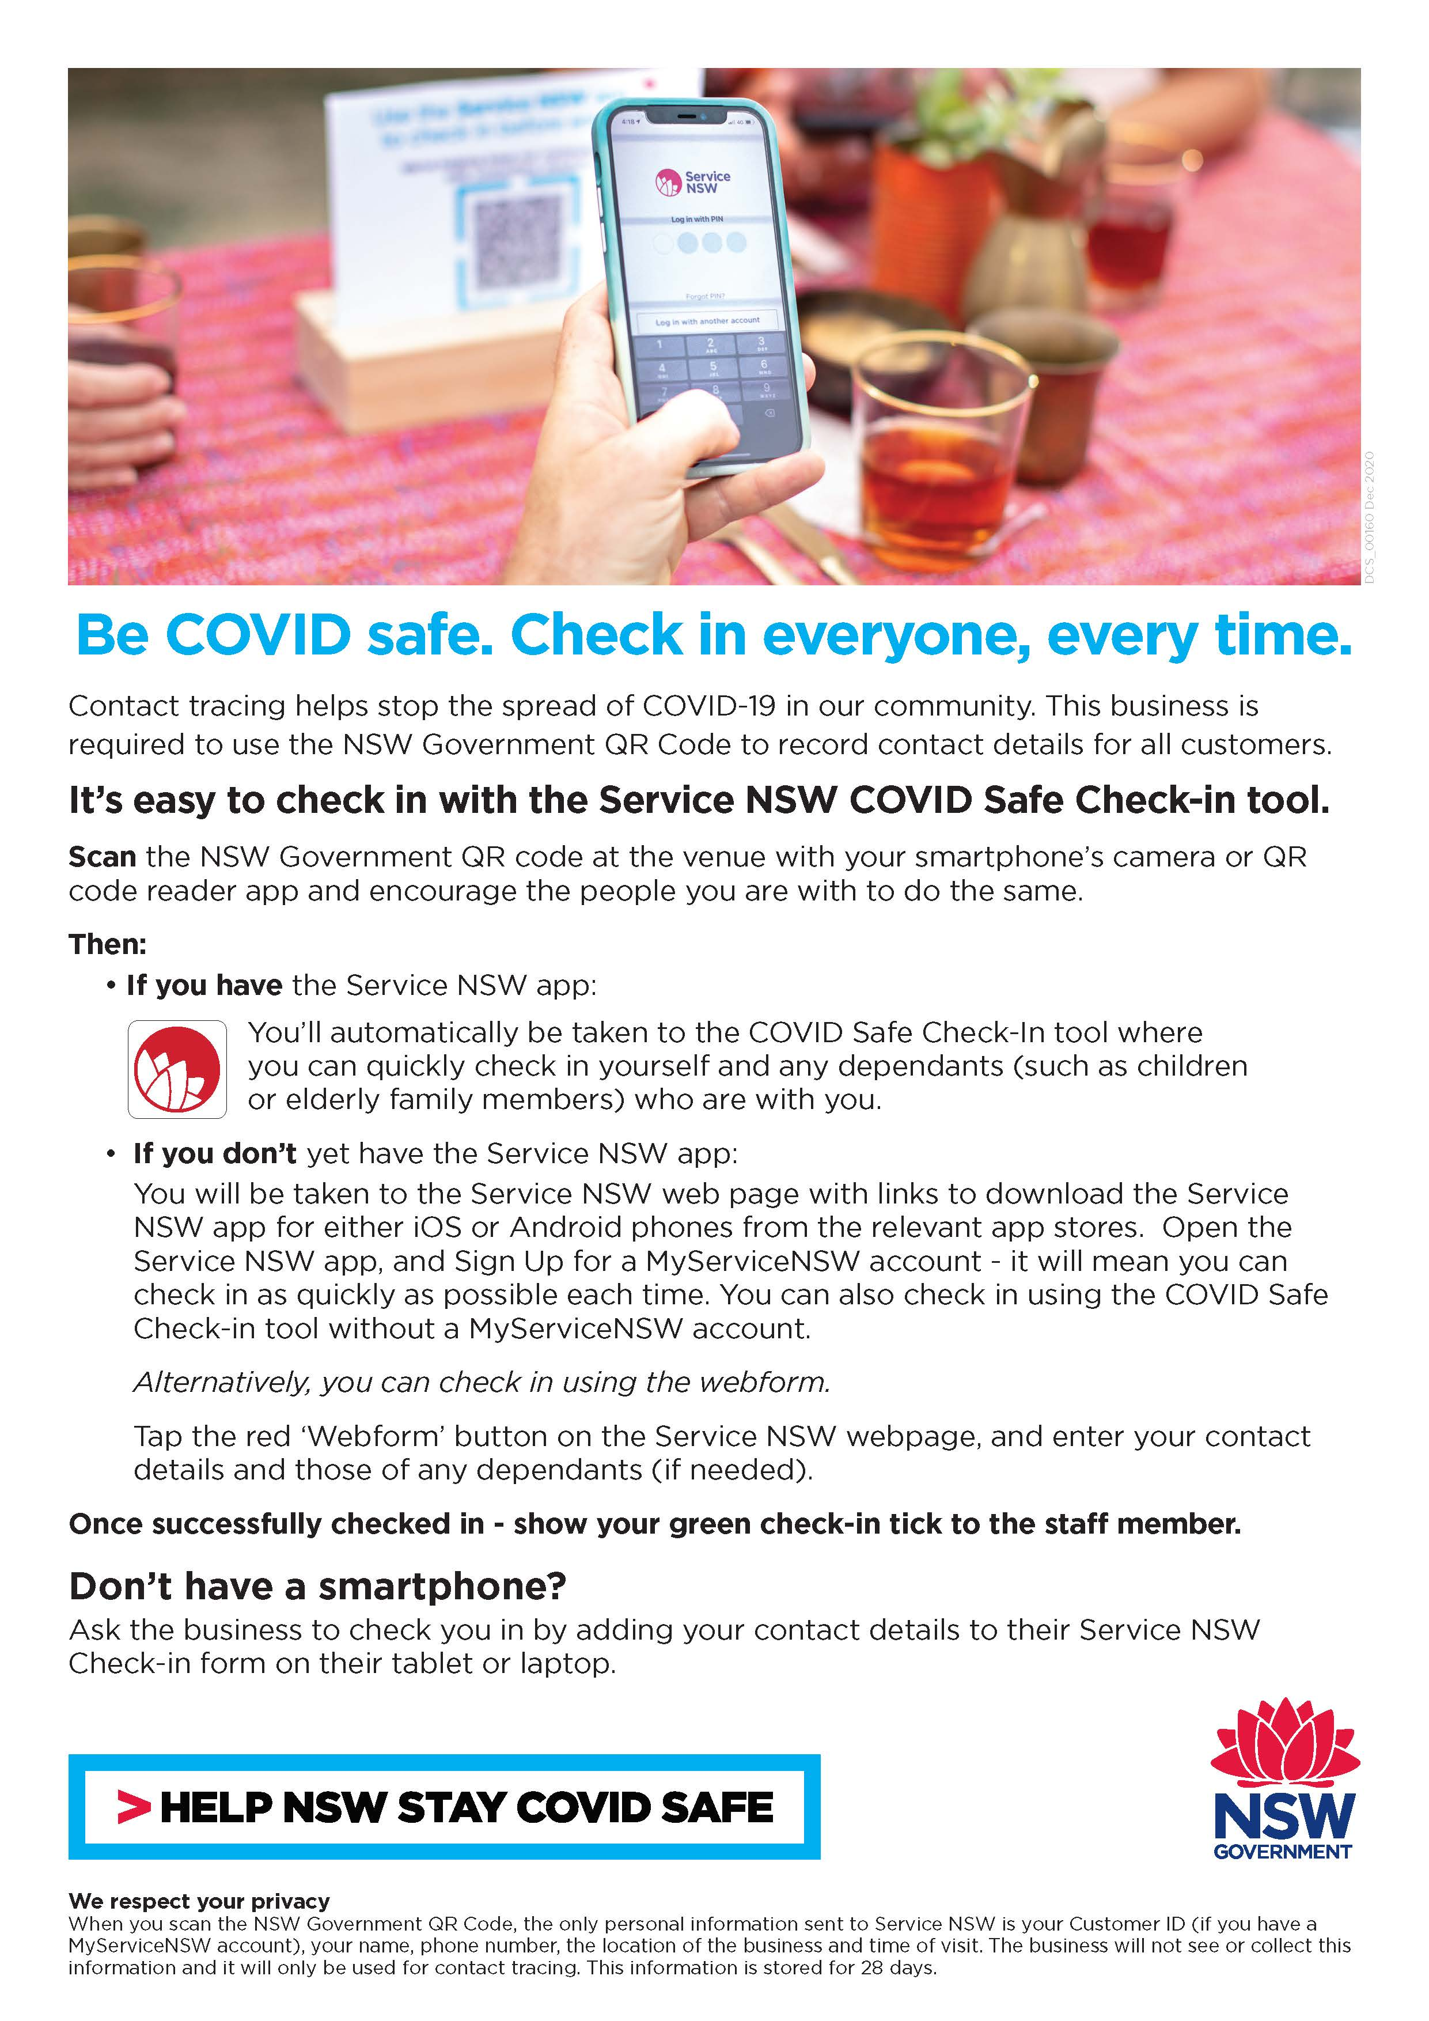
Business to customers: posters
Posters are available to download at www.nsw.gov.au/covid-19/covid-safe/toolkit#qr-code-check-in

