Slide 1
Local Government Elections
Communication toolkit for stakeholders
August 2024
Department of Planning, Housing and Infrastructure – Office of Local Government

Slide 2
Purpose of this toolkit
The local government elections will be held on 14 September 2024.
Councillors play a crucial role in local government, representing residents by addressing community concerns, participating in decision-making about the delivery of services and infrastructure, and contributing to the development of strategies that impact their local government area.
It is important our councils reflect the communities they represent. With more diversity, the policies, strategies, and decisions of councils will better reflect the views and needs of their communities.
We need people from all backgrounds to stand for their community at the local government elections.
This toolkit has been developed to help you communicate with your community about the importance of increasing diversity on local councils.
How to use this toolkit​:
This toolkit includes suggested text for newsletter, website and social content, as well as links to the Office of Local Government ‘Local Government Elections’ webpage, 'Become a councillor' webpage, candidate guides, an online interactive candidate tool, fact sheets (including translations) and animations that can be easily used in information campaigns on your chosen media channels.
To download resources:​
Click on the accompanying link.
Then click ‘Download’ or right click to ‘Save’.
Quick links to important information:
Important information regarding the local government elections
Information about becoming a councillor
Candidate guide (PDF)
Candidate online interactive tool

Slide 3
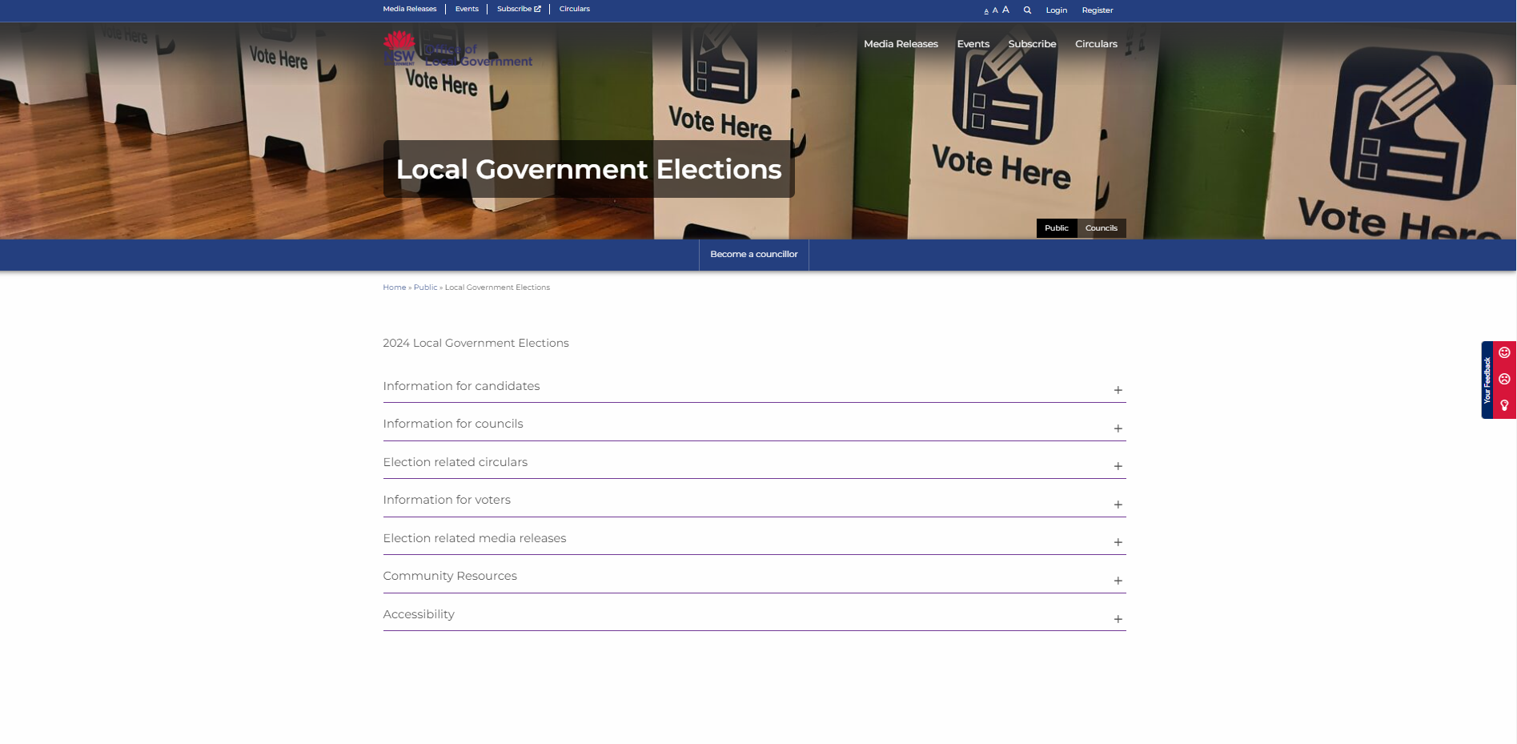
Key websites and links
Local Government Elections webpage: www.olg.nsw.gov.au/public/local-government-elections/

Slide 4
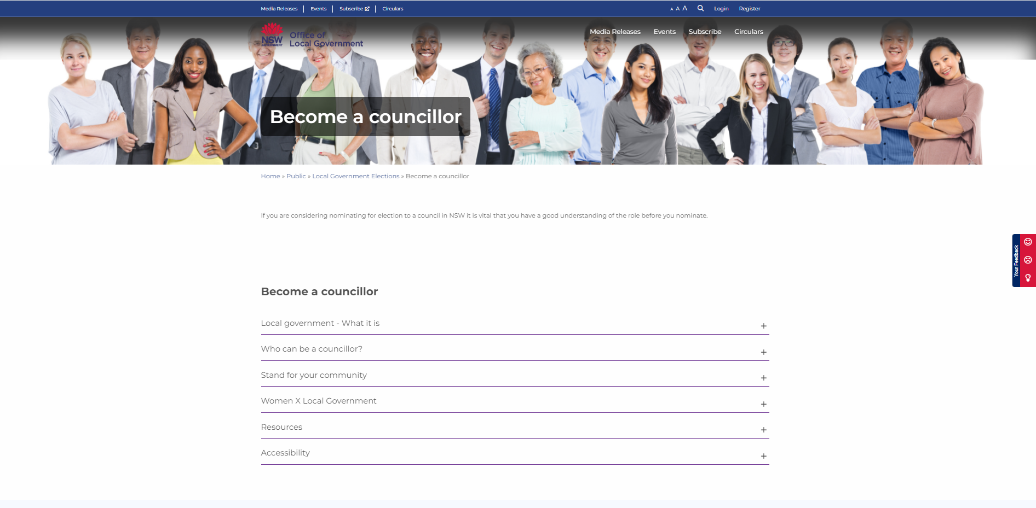
Key websites and links
Become a councillor webpage: www.olg.nsw.gov.au/public/local-government-elections/become-a-councillor/

Slide 5
Newsletter / website copy
Suggested copy for councils
Heading:
Campaign encourages diversity in local government
Local government elections will be held on 14 September. The elections are a key opportunity to create effective – and more representative – councils.
Councillors play a vital role in helping to shape their local communities. It is therefore important our councils reflect the communities they represent.
Analysis carried out by the Office of Local Government after the last local government elections, held in December 2021, showed:
39 per cent of councillors were women
10.1 per cent of councillors were linguistically diverse
4.3 per cent of councillors were aged under 30
3.9 per cent of councillors were Aboriginal and/or Torres Strait Islander; and
2.2 per cent of councillors had a disability
The Office of Local Government is conducting a diversity campaign, targeting underrepresented groups and encouraging them to consider standing for their community.
Are you interested in running for local government, or do you know someone who’d make a good councillor?
Nominations for the local government elections will be open from 5-14 August.
For more information, go to:
Local Government Elections - Office of Local Government NSW
Become a councillor - Office of Local Government NSW

Slide 6
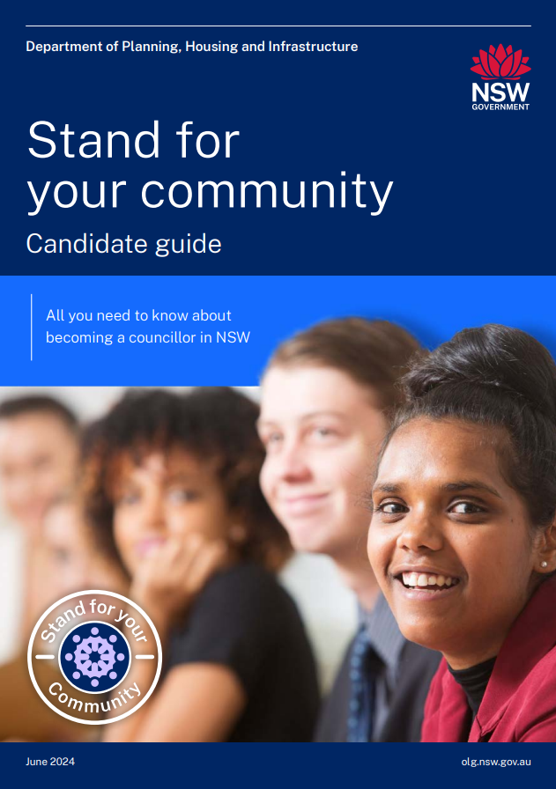
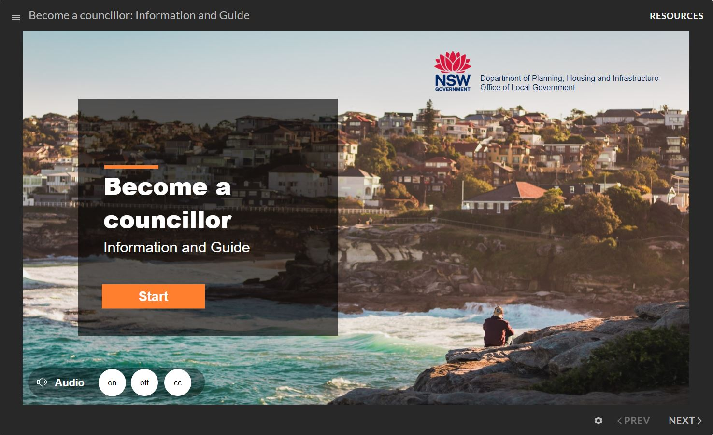
Candidate resources
Click here to download Stand for your community – Candidate guide (2768KB)
Click here for the Become a councillor: Information and Guide

Slide 7
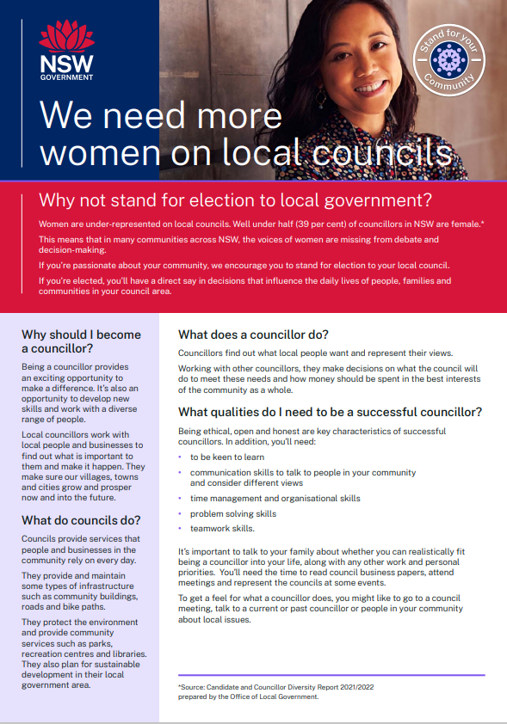
Fact sheet: Stand for your Community - Women
Click here to download fact sheet (PDF 227KB)

Slide 8
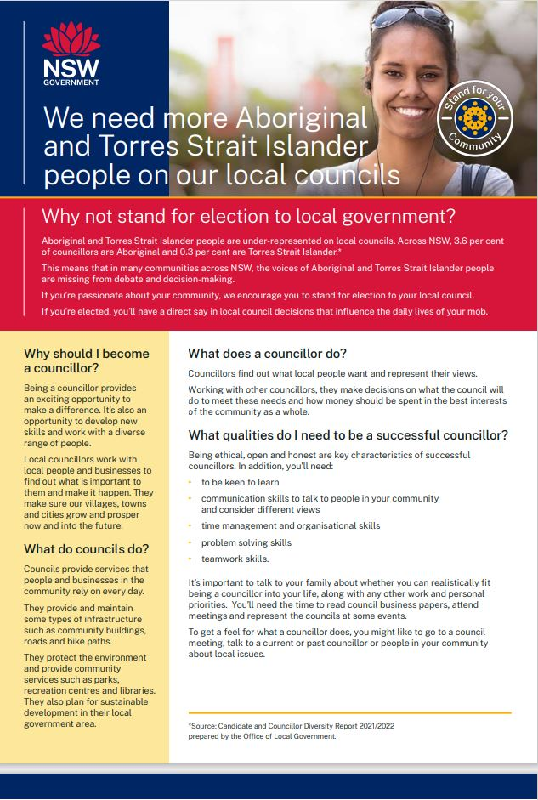
Fact sheet: Stand for your Community – Aboriginal and Torres Strait Islander people
Click here to download fact sheet (PDF 203KB)

Slide 9
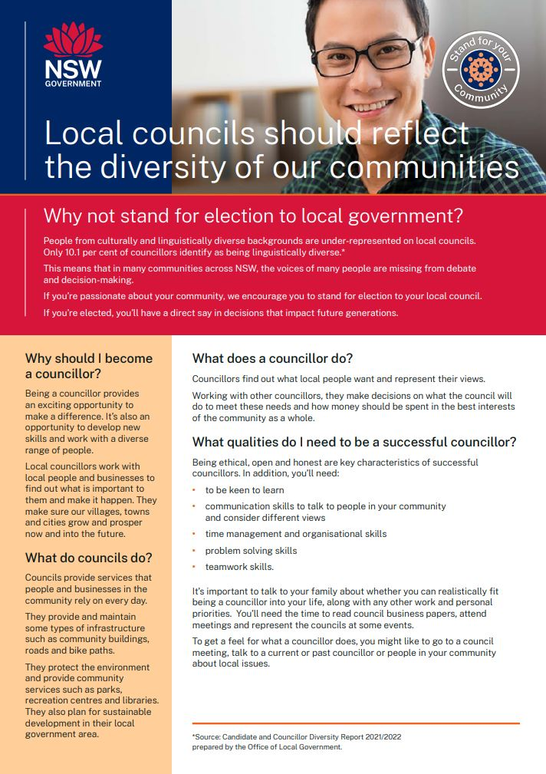
Fact sheets: Stand for your Community – People from culturally and linguistically diverse backgrounds
Click here to download fact sheet (PDF 207KB)
Languages available:
Arabic
Turkish
Simplified Chinese (Mandarin)
Vietnamese
Spanish
Traditional Chinese (Cantonese)
Italian
Greek
Filipino
Korean

Slide 10
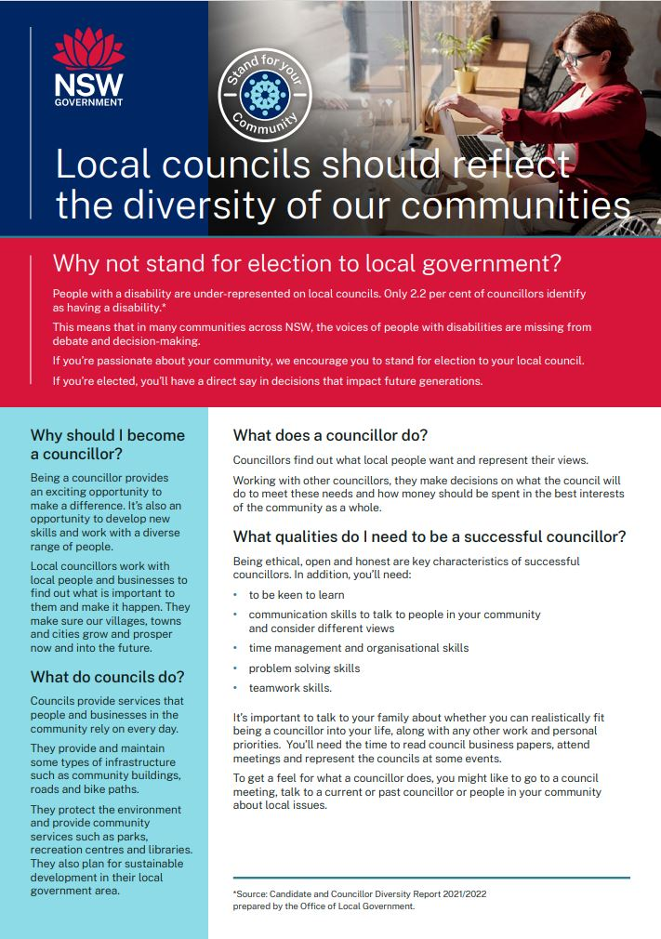
Fact sheet: Stand for your Community – People with disability
Click here to download fact sheet (PDF 214KB)
Special arrangements can be made for our publications to be provided in large print or an alternative media format. Additionally, a translation service is available. If you need any of these services, please contact Client Services on 02 4428 4100. Visit Accessibility for more information.

Slide 11
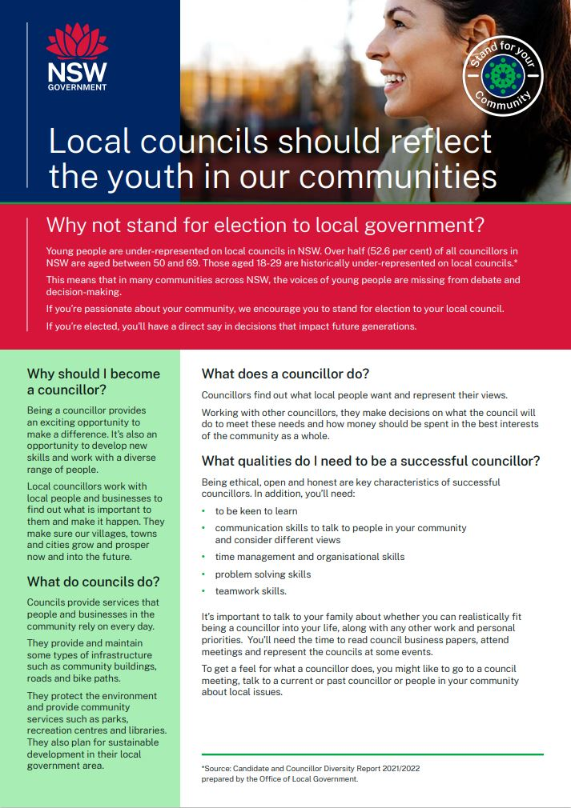
Fact sheet: Stand for your Community – Young people
Click here to download fact sheet (PDF 201KB)

Slide 12
Animations * The animations are intended for use during the nomination period for the Local Government elections and the license to use the audio will expire in June 2025.
Animation 1: About Local Government and the role of a councillor – 1.34 minutes (mp4)
Animation 2: Represent your local community as a councillor – 1.24 minutes (mp4)

Slide 13
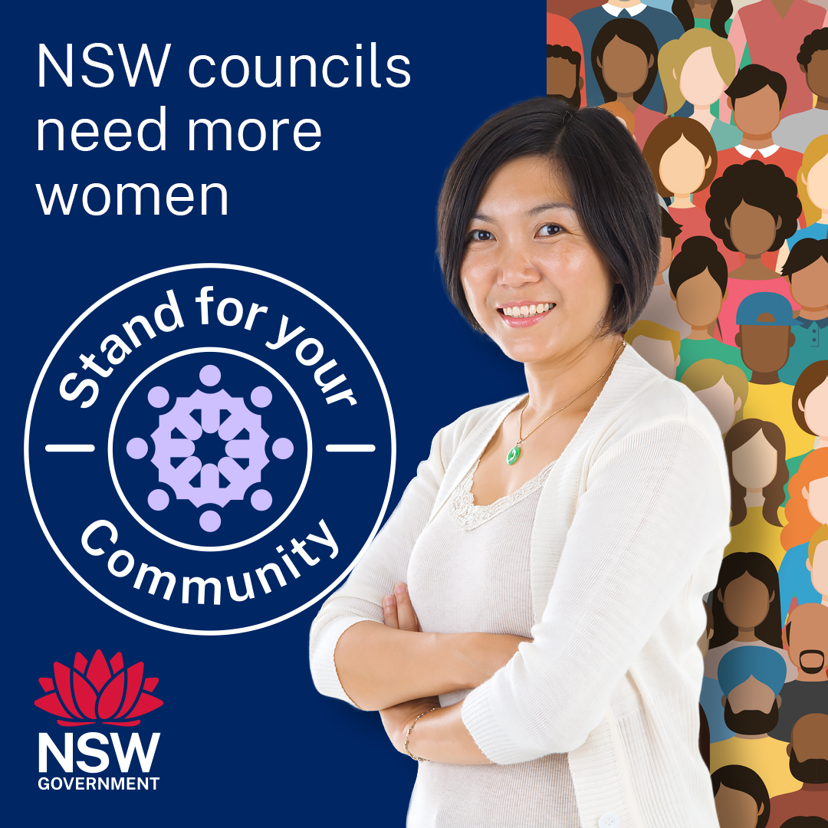
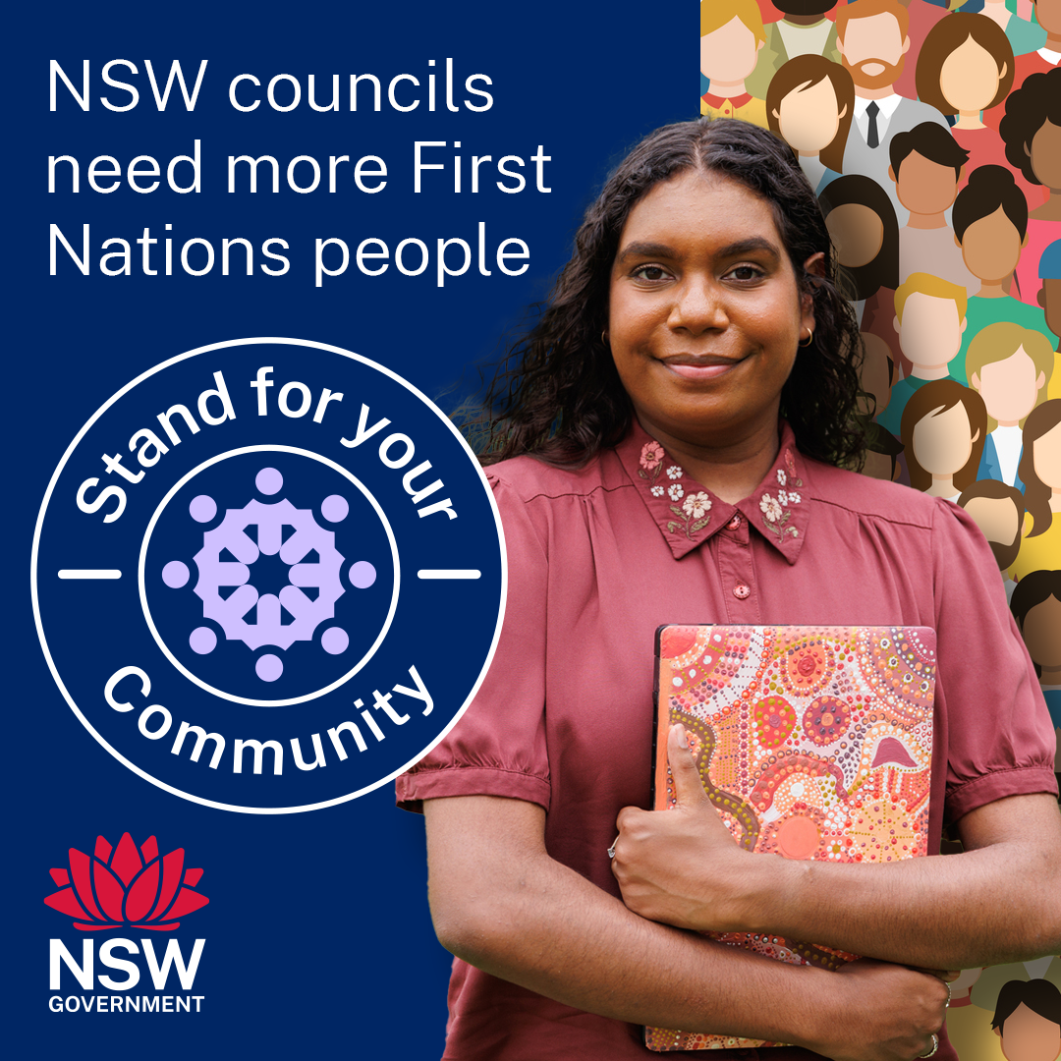
Social content: Stand for your Community
Click here to download social tile (PNG 270KB)
Click here to download social tile (PNG 346KB)
Post: This September, the NSW Government encourages people from all backgrounds to stand for election to their local council. Councils impact daily life and more women are needed for better community representation. You, or someone you know, could help make life better in your community. Nominations open on 5 August and close 14 August. For more information, go to Become a councillor
Post: This September, the NSW Government encourages people from all backgrounds to stand for election to their local council. NSW needs more candidates who identify as Aboriginal to represent their communities. You, or someone you know, could help make life better in your community. Nominations open on 5 August and close 14 August. For more information, go to Become a councillor

Slide 14
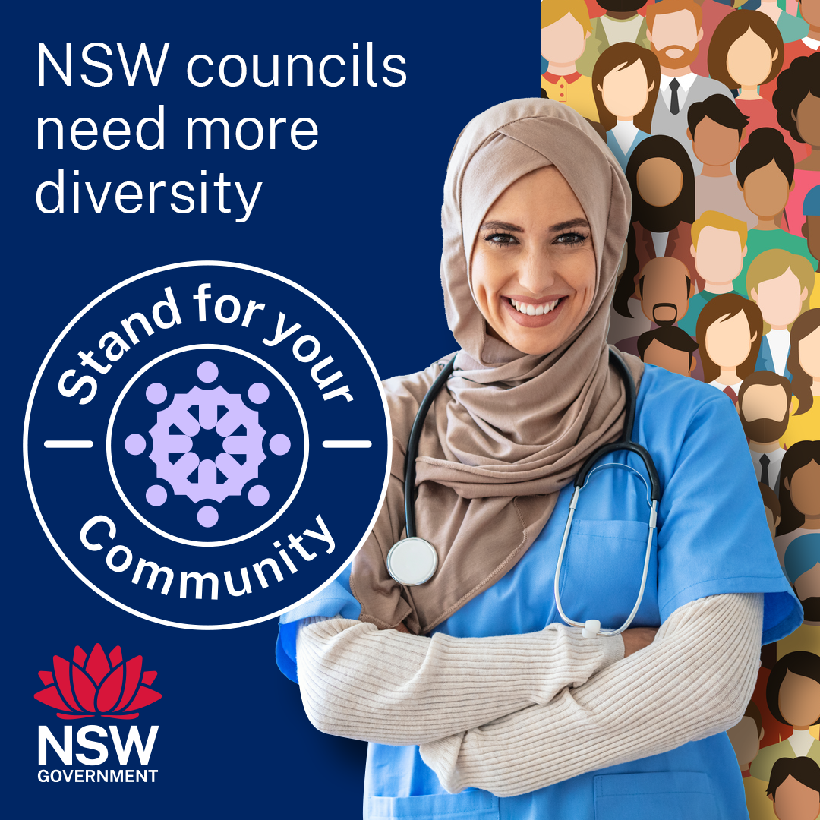
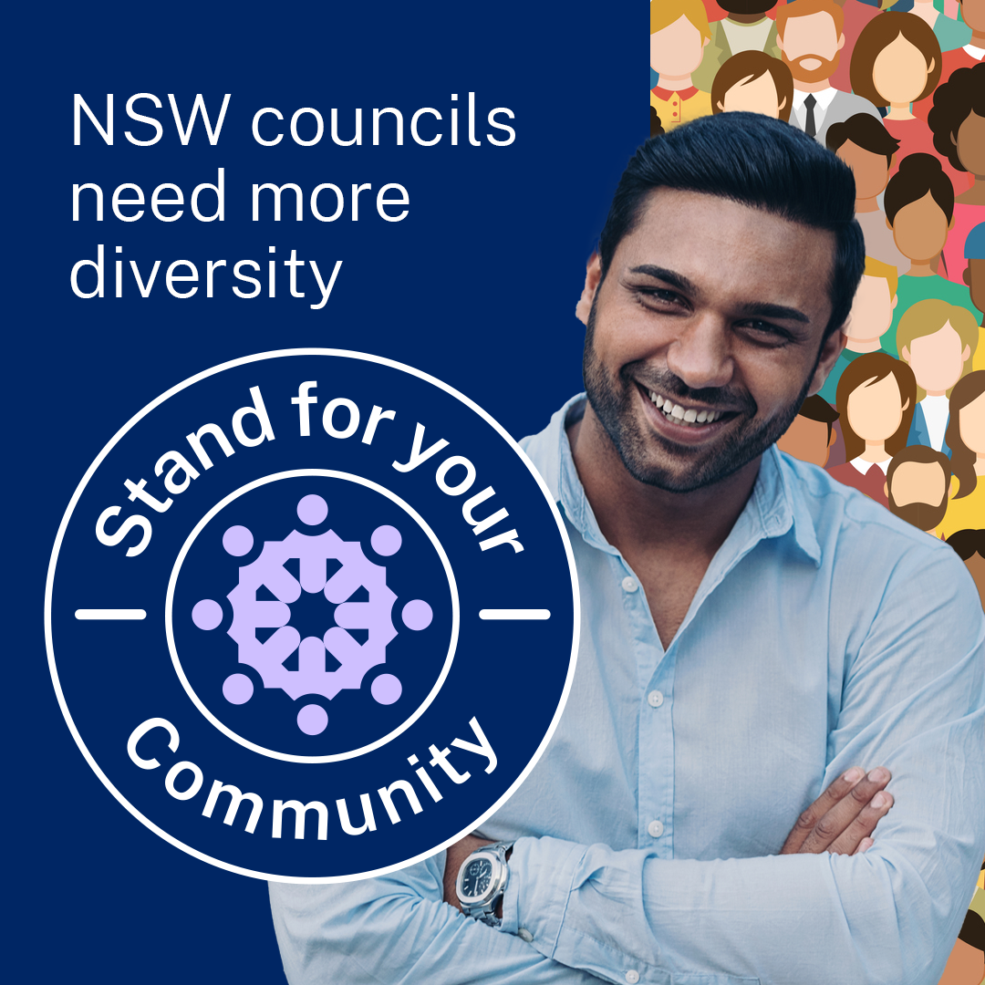
Social content: Stand for your Community
Click here to download social tile (PNG 318KB)
Click here to download social tile (PNG 272KB)
Post: This September, the NSW Government is calling on people from all backgrounds to stand for election to their local council. Councils impact daily life and more diversity is needed for better community representation. You, or someone you know, could help make life better in your community. Nominations open on 5 August and close 14 August. For more information, go to Become a councillor
Post: This September, the NSW Government is calling on people from all backgrounds to stand for election to their local council. Councils impact daily life and more diversity is needed for better community representation. You, or someone you know, could help make life better in your community. Nominations open on 5 August and close 14 August. For more information, go to Become a councillor

Slide 15
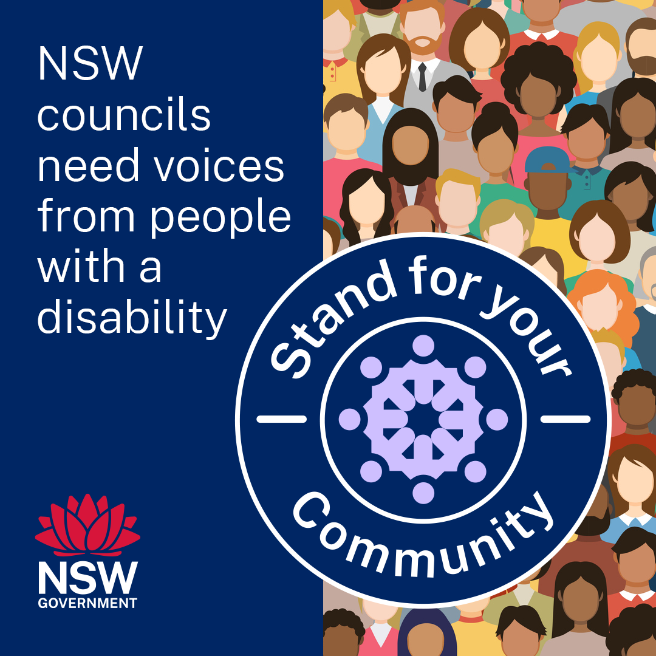
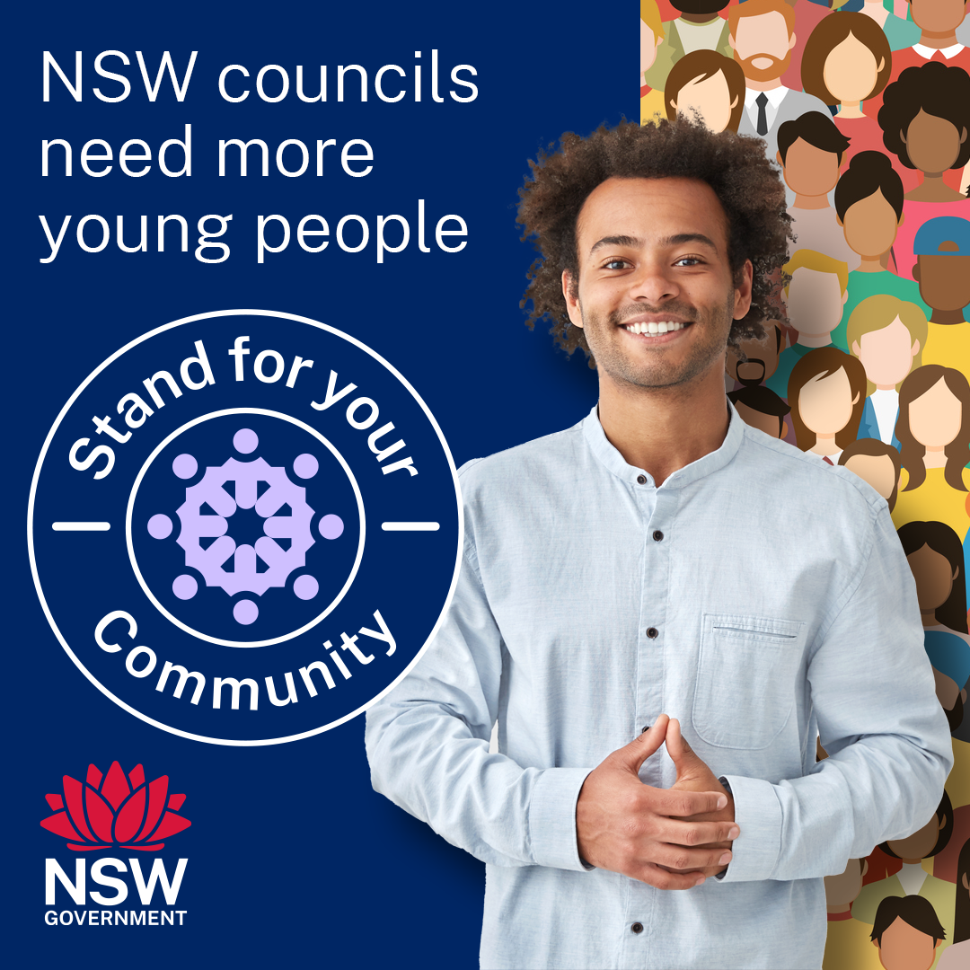
Social content: Stand for your Community
Click here to download social tile (PNG 458KB)
Click here to download social tile (PNG 918KB)
Post: This September, the NSW Government is calling on people from all backgrounds to stand for election to their local council. Your council plays a vital role in your local community and councillors’ decisions directly affect your daily life. You, or someone you know, could help make life better in your community. Nominations open on 5 August and close 14 August. For more information, go to Become a councillor
Post: This September, the NSW Government is calling on people from all backgrounds to stand for election to their local council. Your council plays a vital role in your local community and councillors’ decisions directly affect your daily life. More diversity on councils leads to better representation for your community. You, or someone you know, could help make life better in your community. Nominations open on 5 August and close 14 August. For more information, go to Become a councillor

Slide 16
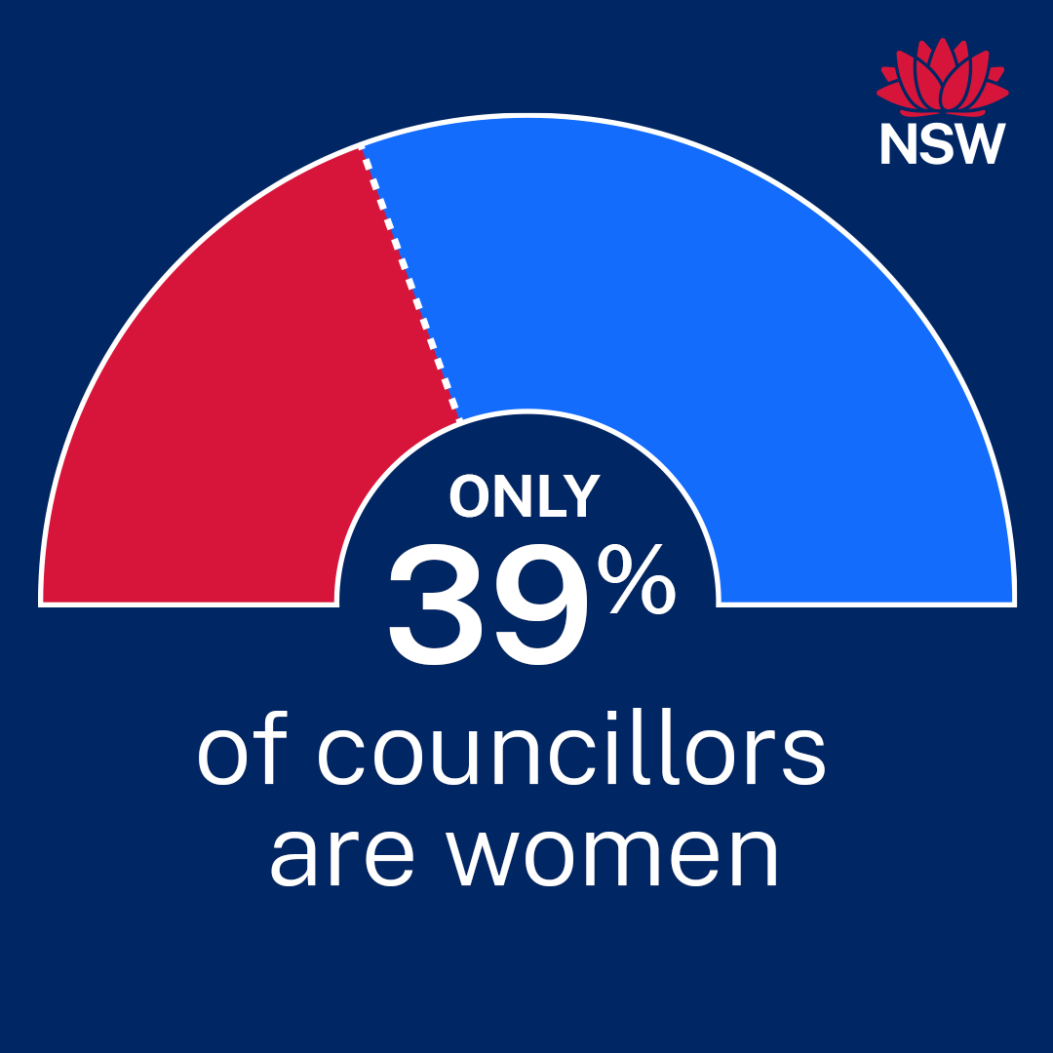
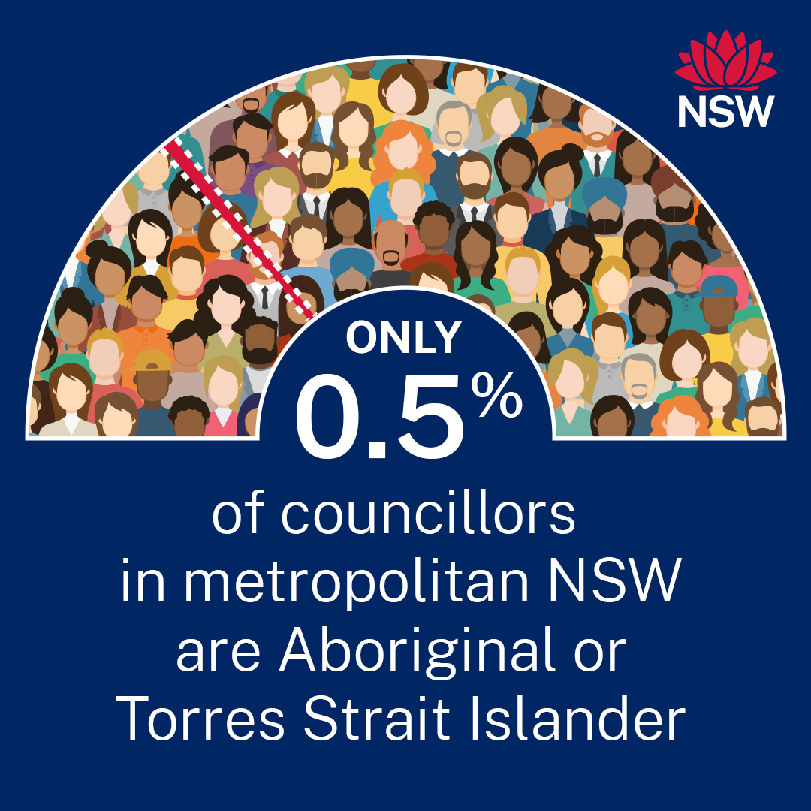
Social content: Who is representing your voice? * The data on the following social media tiles (pages 16-18) has been sourced from the Office of Local Government’s Candidate and Councillor Diversity Report 2021/22.
Click here to download social tile (PNG 85KB)
Click here to download social tile (PNG 276KB)
Post: Women make up more than half the population but only 39% of people elected to local councils in NSW are women. This means there is a clear opportunity for women to have a stronger voice in debate and decision-making in many communities. If you’re passionate about your community, consider standing for election to your local council. For more information, go to Become a councillor
Post: NSW has Australia’s largest population of Aboriginal and Torres Strait Islander people but the percentage of First Nations councillors varies across councils. This means the voices of Aboriginal and Torres Strait Islander people are missing from debate and decision-making in many communities. If you’re passionate about your community, consider standing for election to your local council. For more information, go to Become a councillor

Slide 17
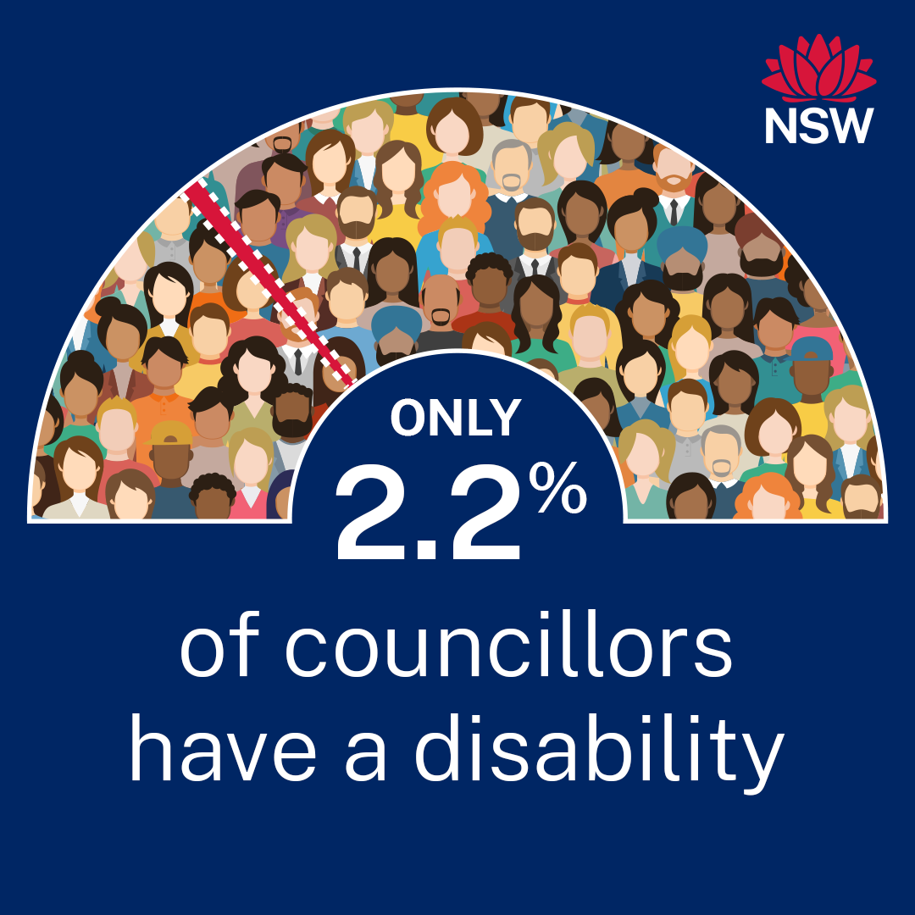
Social content: Who is representing your voice?
Click here to download social tile (PNG 77KB)
Click here to download social tile (PNG 268KB)
Post: More than one in five people in NSW speak a language other than English at home but only one in 10 councillors are linguistically diverse. NSW councils need to represent diverse communities. If you’re passionate about your community, we encourage you to stand for election to your local council. For more information, go to Become a councillor
Post: Only a small percentage of councillors identify as having a disability. This means the voices of people with disability are missing from debate and decision-making in many communities. If you’re passionate about your community, we encourage you to stand for election to your local council. For more information, go to Become a councillor

Slide 18
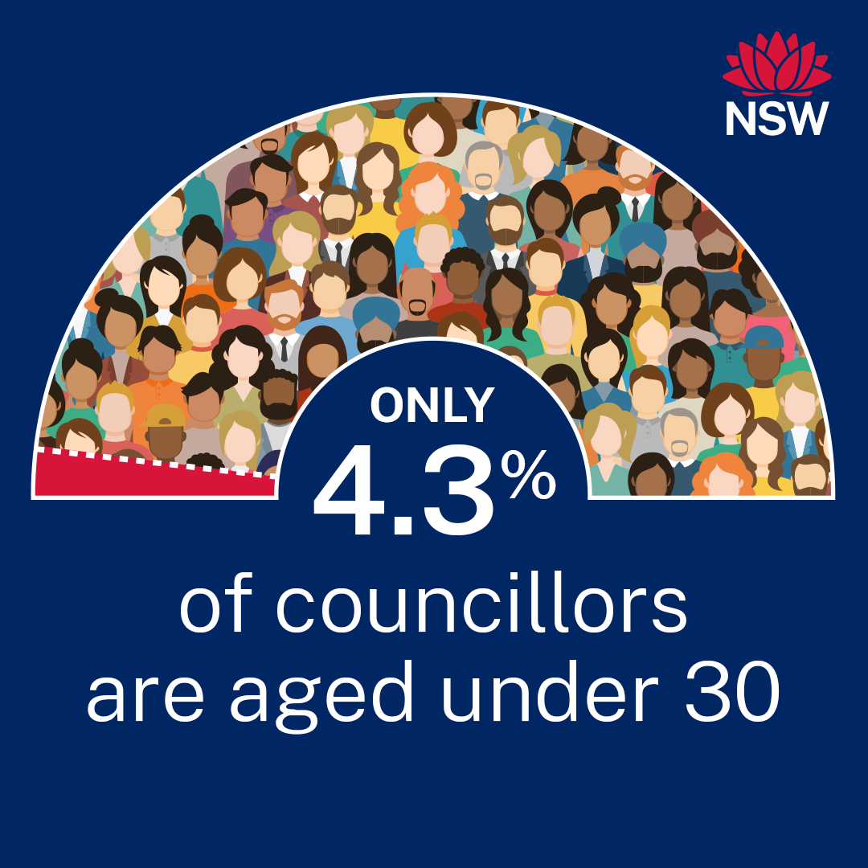
Social content: Who is representing your voice?
Click here to download social tile (PNG 258KB)
Post: Only a small percentage of councillors are under the age of 30. This means that in many communities the voices of young people are missing from debate and decision-making. Young candidates bring fresh perspectives, innovative ideas and an understanding of the issues facing their peers. If you’re passionate about your community, consider standing for election to your local council. For more information, go to Become a councillor

Slide 19
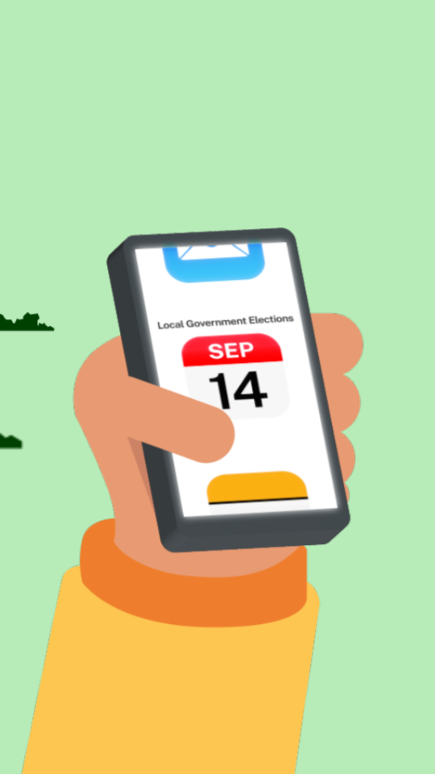
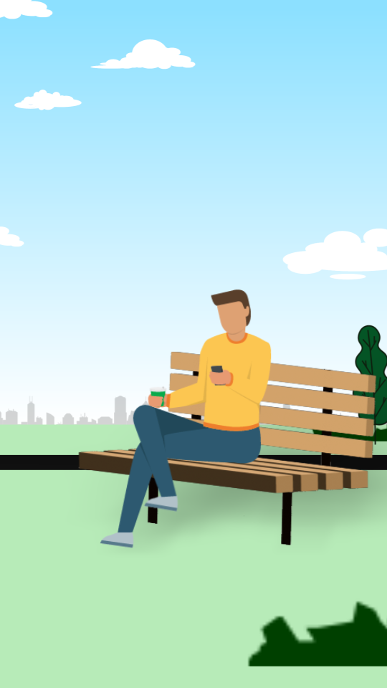
Social content – animations * The animations are intended for use during the nomination period for the Local Government elections and the license to use the audio will expire in June 2025.
Animation 1: About Local Government and the role of a councillor – 18 seconds (mp4)
Animation 2: Represent your local community as a councillor – 19 seconds (mp4)

