Slide 1
A fresh start for local government apprentices, trainees and cadets program
Communication toolkit for stakeholders
November 2024
Department of Planning, Housing and Infrastructure – Office of Local Government

Slide 2
Purpose of this toolkit
The NSW Government is providing funding through the A fresh start for local government apprentices, trainees and cadets program to support councils to employ additional apprentices, trainees and cadets.
The funding will allow councils to directly hire new staff, boosting the local government workforce and providing genuine career opportunities for jobseekers and school leavers.
This toolkit has been developed to help councils communicate with their community about roles available.
How to use this toolkit​:
This toolkit includes suggested text for newsletters, websites and social content, as well as a link to the Office of Local Government’s Apprentices and Trainees webpage. These assets can be easily used in information campaigns on your chosen media channels.
To download resources:​
Click on the accompanying link.
Then click ‘Download’ or right click to ‘Save’.
Quick links to important information:
Information about the A fresh start for local government apprentices, trainees and cadets program
Program guidelines – round 1 (PDF)
Contact details for local councils

Slide 3
Key websites and links
A fresh start for local government apprentices, trainees and cadets program webpage: https://olg.nsw.gov.au/apprentice-trainee
Councils wishing to hire apprentices and trainees may also find these websites useful:
Skills NSW: https://skills.education.nsw.gov.au/
Apprenticeship Support Australia: https://www.apprenticeshipsupport.com.au/Home

Slide 4
Newsletter / website copy
Suggested copy for councils
Heading:
Council apprenticeships, traineeships and cadetships now available
Text:
Want to do something valuable for your community while being paid to learn?
The NSW Government is providing funding so councils can hire more apprentices, trainees and cadets.
[INSERT COUNCIL NAME] is recruiting now for [INSERT APPRENTICE/ TRAINEE/ CADET] roles to start in early 2025.
An apprenticeship, traineeship or cadetship with a council can be a great way to start a successful career.
You could:
Be paid while you learn from experienced mentors
Gain hands-on experience
Experience a diverse range of tasks and projects
Earn a nationally recognised qualification that’s valued in the job market
Make a positive difference in your community
Kickstart your future career in local government
Are you interested in becoming an apprentice, trainee or cadet in local government?
To apply, go to [INSERT COUNCIL JOB/AD/COUNCIL EOI DETAILS]
Applications close [INSERT DATE]
For information about the program, go to olg.nsw.gov.au/apprentice-trainee
EDM banner_600 x 200_1.png (90KB)
EDM banner_600 x 200_2.png (97KB)
EDM banner_600 x 200_3.png (83KB)

Slide 5
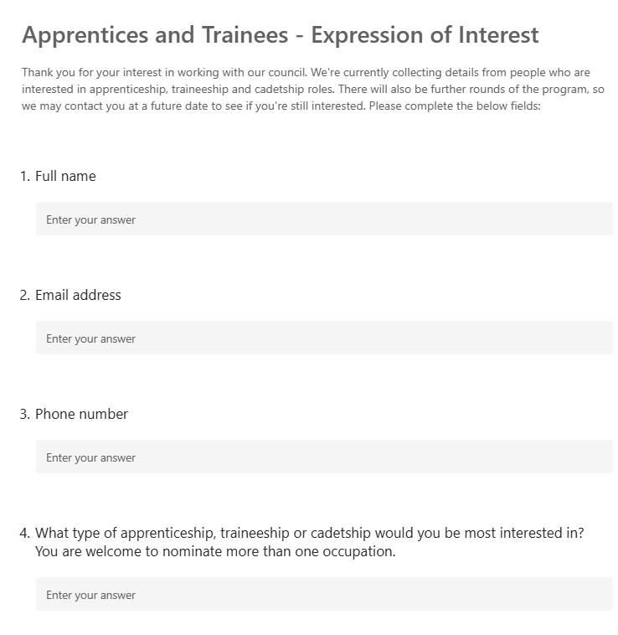
Resources: sample Expression of Interest form
Information for councils:
An advertising campaign for the A fresh Start for Local Government Apprentices, Trainees and Cadets program commenced on 11 November.
On hearing about the program, interested jobseekers and school leavers may contact your council.
We encourage councils to create an Expression of Interest form on the home page of their website, which will enable them to keep track of interest and enquiries about the program.
Sample Expression of Interest form
Expression of Interest form
An Expression of Interest (EOI) form can be set up using a program such as Microsoft Forms.
For more information go to: https://support.microsoft.com/en-au/office/create-a-form-with-microsoft-forms-4ffb64cc-7d5d-402f-b82e-b1d49418fd9d
If using Microsoft Forms, once the form has been set up, click on "Present" to obtain the form's URL, which you can then put on your council’s website or share with applicants. Once you’ve developed the form and it’s live, go to "View responses" to see a summary of applicant responses.
It is suggested councils use the EOI form to capture the following information:
Full name
Email address
Phone number
What type of apprenticeship, traineeship or cadetship would you be most interested in? You are welcome to nominate more than one occupation.

Slide 6
Resources: suggested script
Suggested script for participating councils – to assist with phone enquiries during November and December 2024
Thanks for your interest in working with our council.
We are planning to participate in the Government’s program and should know how many positions we’ll be able to offer soon.
We’re currently collecting details from people who are interested in the apprenticeship, traineeship or cadetship roles [REMOVE IF NOT RELEVANT].
Can I please ask you to visit our website and complete the Expression of Interest form, so we have your details?
You’ll find the form on our website if you go to [INSERT THE COUNCIL WEBSITE URL HERE].
There will also be further rounds of this program, so we may contact you at a future date to see if you’re still interested.
Thanks for your call and for your interest in the program.

Slide 7
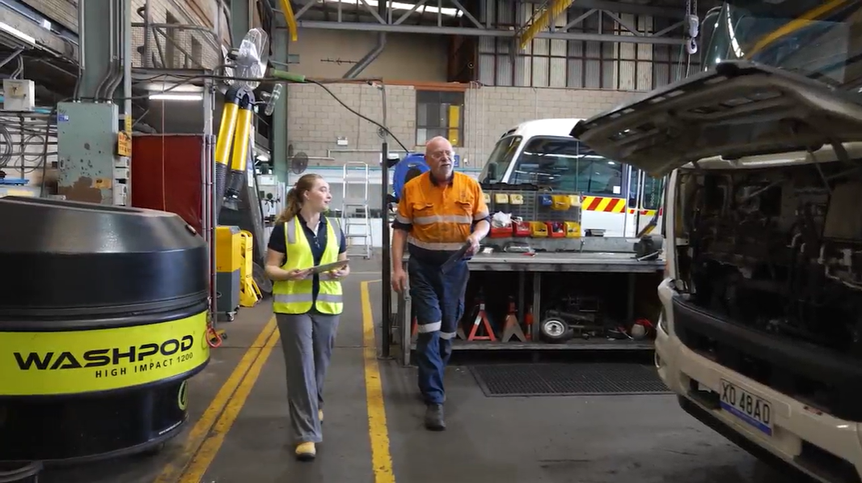
Video content
Click here to download: long form-16x9.mp4
Click here to download: Indi-social-9x16.mp4
Click here to download: Liam-social-9x16.mp4
Click here to download: Indi-social-1x1.mp4
Click here to download: Liam-social-1x1.mp4

Slide 8
Website tiles
Click here to download web tile - 728x90.png (57KB)
Click here to download web tile 320x50_1.gif (9KB)
Click here to download web tile - 728x90.png_2.png (59KB)
Click here to download web tile 320x50_2.gif (9KB)
Click here to download web tile 300x250.gif
Click here to download web tile 300x250.png (69KB)
Click here to download web tile 300x250_2.png (75KB)

Slide 9
Social content
Click here to download social tile (PNG 298KB)
Click here to download social tile (PNG 323KB)
Post: Want to do something valuable for your community while being paid to learn? [INSERT COUNCIL NAME] is recruiting now for apprentices, trainees and cadets to start in early 2025. You could benefit from the guidance of experienced mentors and gain skills and qualifications that are valued in the job market. For more information, go to olg.nsw.gov.au/apprentice-trainee
Post: Are you interested in starting an apprenticeship, traineeship or cadetship? [INSERT COUNCIL NAME] is recruiting now for roles to start in early 2025. You could benefit from the guidance of experienced mentors and gain skills and qualifications that are valued in the job market. For more information, go to olg.nsw.gov.au/apprentice-trainee

Slide 10
Social content
Click here to download social tile (PNG 217KB)
Click here to download social tile (PNG 201KB)
Click here to download social tile (PNG 186KB)
Post: Are you interested in starting an apprenticeship? [INSERT COUNCIL NAME] is recruiting now for roles to start in early 2025. You could benefit from the guidance of experienced mentors and gain skills and qualifications that are valued in the job market. For more information, go to olg.nsw.gov.au/apprentice-trainee
Post: Are you interested in starting a traineeship? [INSERT COUNCIL NAME] is recruiting now for roles to start in early 2025. You could benefit from the guidance of experienced mentors and gain skills and qualifications that are valued in the job market. For more information, go to olg.nsw.gov.au/apprentice-trainee
Post: Are you interested in starting a cadetship? [INSERT COUNCIL NAME] is recruiting now for roles to start in early 2025. You could benefit from the guidance of experienced mentors and gain skills and qualifications that are valued in the job market. For more information, go to olg.nsw.gov.au/apprentice-trainee

