Slide 1
A fresh start for local government apprentices, trainees and cadets program Round 2
Communication toolkit for stakeholders
May 2025
Department of Planning, Housing and Infrastructure – Office of Local Government

Slide 2
Purpose of this toolkit
The NSW Government is providing funding through the A fresh start for local government apprentices, trainees and cadets program to support councils to employ additional apprentices, trainees and cadets.
The funding will allow councils to directly hire new staff, boosting the local government workforce and providing genuine career opportunities for jobseekers and school leavers.
This toolkit has been developed to help councils communicate with their community about roles available.
How to use this toolkit​:
This toolkit includes suggested text for newsletters, websites and social content, as well as a link to the Office of Local Government’s Apprentices and Trainees webpage. These assets can be easily used in information campaigns on your chosen media channels.
To download resources:​
Click on the accompanying link.
Then click ‘Download’ or right click to ‘Save’.
Quick links to important information:
Information about the A fresh start for local government apprentices, trainees and cadets program
Program guidelines – round 2 (PDF)

Slide 3
Key websites and links
A fresh start for local government apprentices, trainees and cadets program webpage: https://olg.nsw.gov.au/apprentice-trainee
Councils wishing to hire apprentices and trainees may also find these websites useful:
Skills NSW: https://skills.education.nsw.gov.au/
Apprenticeship Support Australia: https://www.apprenticeshipsupport.com.au/Home

Slide 4
Newsletter / website copy
Suggested copy for councils
Heading:
Start your career with a local council – earn while you learn!
Body copy: Looking for a way to kickstart your career and make a real difference in your community?
Thanks to NSW Government funding, [INSERT COUNCIL NAME] is now hiring apprentices, trainees and cadets to start in xx.
These roles offer a great pathway to build your skills, gain real work experience and get paid – all while working towards a nationally recognised qualification.
As an apprentice, trainee or cadet, you’ll:
Be paid while you learn from experienced mentors
Get hands-on experience with real projects
Build practical skills that employers value
Gain a qualification recognised across Australia
Contribute to meaningful work in your local area
Set yourself up for a successful future in local government
Interested? Apply now at [INSERT COUNCIL JOB/AD/COUNCIL EOI DETAILS]
Applications close [INSERT DATE]
Find out more about the program at olg.nsw.gov.au/apprentice-trainee
Click here to download: EDM banner_600 x 200_1.png (149KB)
Click here to download: EDM banner_600 x200_2.png (157KB)

Slide 5
Resources: sample media release
Information for councils
​
To advise the community of their recruitment efforts and encourage future recruitment, councils may wish to send a media release to local media.
Please see adjacent a sample media release which can be adjusted with details for each individual council.
Click here to download: Sample Fresh Start round 2 media release
​

Slide 6
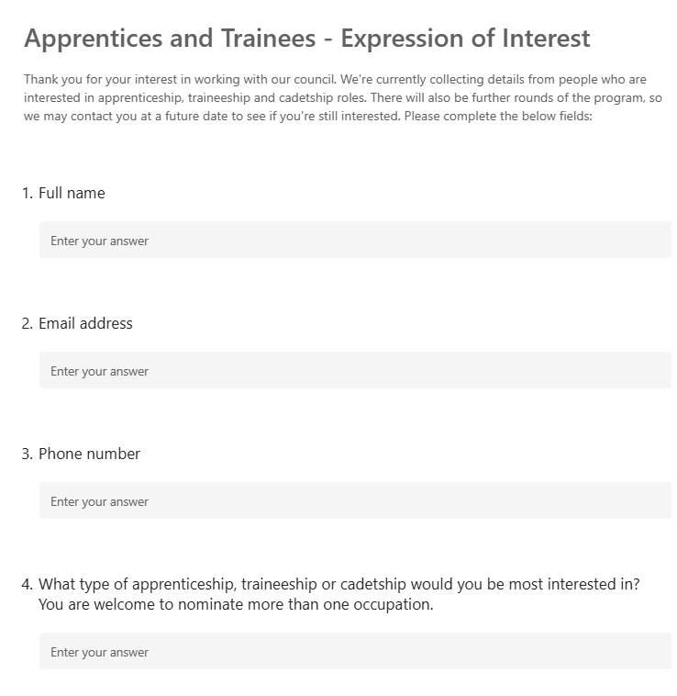
Resources: sample Expression of Interest form
Information for councils:
An advertising campaign for round 2 of the A fresh Start for Local Government Apprentices, Trainees and Cadets program commenced on 13 May 2025.
On hearing about the program, interested jobseekers and school leavers may contact your council.
We encourage councils to create an Expression of Interest form on the home page of their website, which will enable them to keep track of interest and enquiries about the program.
Sample Expression of Interest form
Expression of Interest form
An Expression of Interest (EOI) form can be set up using a program such as Microsoft Forms.
For more information go to: https://support.microsoft.com/en-au/office/create-a-form-with-microsoft-forms-4ffb64cc-7d5d-402f-b82e-b1d49418fd9d
If using Microsoft Forms, once the form has been set up, click on "Present" to obtain the form's URL, which you can then put on your council’s website or share with applicants. Once you’ve developed the form and it’s live, go to "View responses" to see a summary of applicant responses.
It is suggested councils use the EOI form to capture the following information:
Full name
Email address
Phone number
What type of apprenticeship, traineeship or cadetship would you be most interested in? You are welcome to nominate more than one occupation.

Slide 7
Resources: suggested script
Suggested script for participating councils – to assist with phone enquiries during May and June 2025
Thanks for your interest in working with our council.
We’re currently collecting details from people who are interested in apprenticeship, traineeship or cadetship roles [REMOVE IF NOT RELEVANT].
Can I please ask you to visit our website and complete the Expression of Interest form, so we have your details?
You’ll find the form on our website if you go to [INSERT THE COUNCIL WEBSITE URL HERE].
There will also be further rounds of this program, so we may contact you at a future date to see if you’re still interested.
Thanks for your call and for your interest in the program.

Slide 8
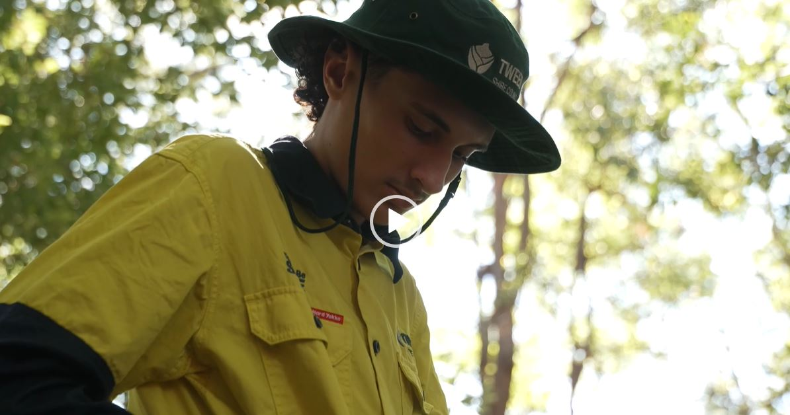
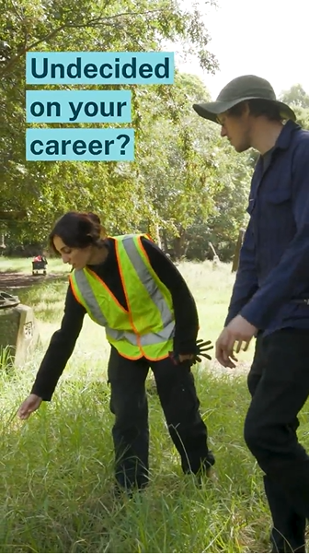
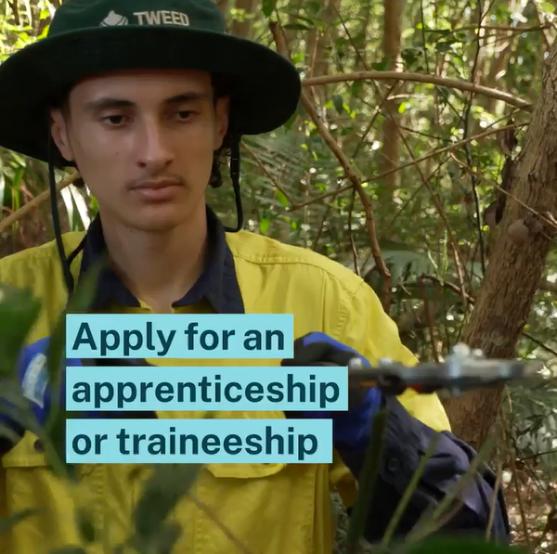
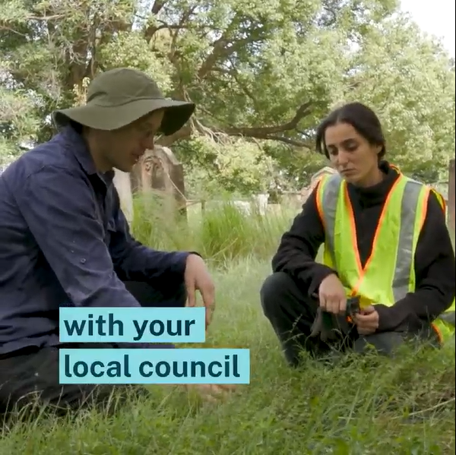
Video content
Click here to download: Long form-16x9.mp4
Click here to download: Social-9x16_Emma_15 sec.mp4
Click here to download: Social-9x16_Blaze_15 sec.mp4
Click here to download: Social-1x1_Blaze_15 sec.mp4
Click here to download: Social-1x1_Emma_15 sec.mp4

Slide 9
Website tiles
Click here to download: Web tile_728x90_1.png (68KB)
Click here to download: Web tile_320x50_1.gif (5KB)
Click here to download Web tile_728x90.png_2.png (73KB)
Click here to download: Web tile_300x250_1.png (85KB)
Click here to download: Web tile_300x250_2.png (99KB)

Slide 10
Social content
Click here to download: Social tile_1 (PNG 97.2KB)
Click here to download: Social tile_2 (PNG 100KB)
Click here to download: Social tile_3 (PNG 99.9KB)
FACEBOOK
Post: Want to make a difference in your community and get paid to learn?
[INSERT COUNCIL NAME] is now recruiting apprentices, trainees, and cadets to start in mid 2025!
This is your chance to:
Learn on the job
Work with experienced mentors
Gain qualifications employers value
Don’t miss out—kickstart your career while helping shape your community.
👉 Find out more: olg.nsw.gov.au/apprentice-trainee
INSTAGRAM
Make a difference. Get paid. Learn new skills.
[INSERT COUNCIL NAME] is now recruiting apprentices, trainees & cadets!
Learn from the best
Earn while you study
Give back to your community
Sounds like your thing? Head to olg.nsw.gov.au/apprentice-trainee to apply.
LINKEDIN
Looking to gain real-world skills while contributing to your local community?
[INSERT COUNCIL NAME] is recruiting for apprentices, trainees, and cadets to join the team in mid 2025.
This program offers:
Paid, on-the-job training
Mentorship from experienced professionals
Nationally recognised qualifications
A great opportunity for young people ready to launch a meaningful career in local government.
Learn more: olg.nsw.gov.au/apprentice-trainee

Slide 11
Social content
Click here to download: Social tile_4 (PNG 103KB)
Click here to download: Social tile_5 (PNG 94KB)
Click here to download Social tile_6: (PNG 855KB)
FACEBOOK
Post: Ready to kickstart your career? [INSERT COUNCIL NAME] is now recruiting apprentices, trainees and cadets to start in mid 2025!
If you’re keen to get hands-on experience, earn while you learn, and work with supportive mentors, this could be your chance. It’s an opportunity to:
Gain valuable skills
Earn qualifications employers want
Start building your future today
Find out more and apply: olg.nsw.gov.au/apprentice-trainee
INSTAGRAM
Want to start your career your way? [INSERT COUNCIL NAME] is hiring apprentices, trainees and cadets to start in mid 2025. It’s a chance to:
Learn new skills
Get paid on the job
Be guided by great mentors
Tap the link in bio or head to olg.nsw.gov.au/apprentice-trainee to learn more.
LINKEDIN
Applications are open. [INSERT COUNCIL NAME] is offering apprenticeship, traineeship and cadetship opportunities to start in mid 2025.
This is a great pathway for young people to gain real-world experience, earn a qualification, and work alongside skilled professionals in a supportive environment. It’s a chance to gain:
Valuable on-the-job training
Accredited qualifications
Career-ready skills
Find out more or share with someone who might be interested: olg.nsw.gov.au/apprentice-trainee

Slide 12
Social content – additional images
Information for councils
Councils wishing to create their own social tiles may wish to use apprentice and trainee photos from OLG's Fresh Start campaign.
To access the images go to the Department of Planning, Housing and Infrastructure image library and register for an account using your council email address. Once you have access, search for "Fresh Start".
In the social post, please credit the Department of Planning, Housing and Infrastructure for the image.

